Slide 1

COMPELLING WEB PRESENCE

Slide 2


Slide 3
CONFERENCE INFORMATION
URL
https://bit.ly/3wNUoC3
FORUM NAME
Cell and Stem Cell Research
THEME
Revolution in Cell Biology

Slide 4
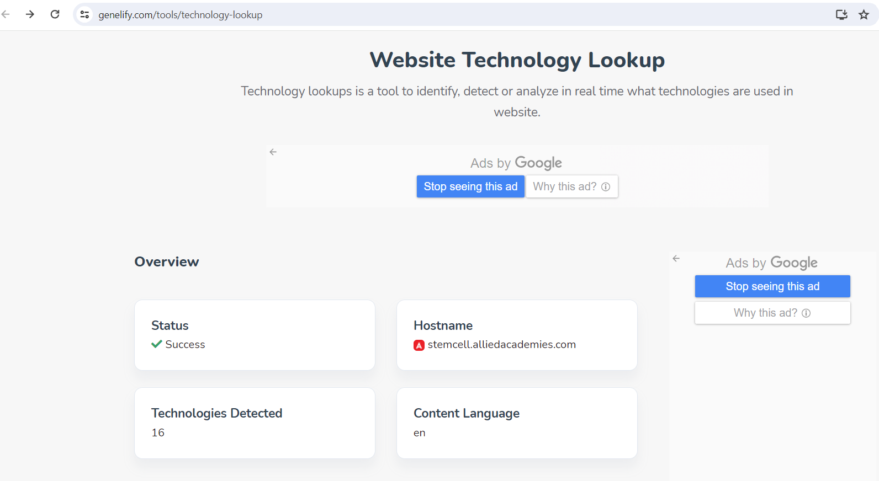

WEBSITE BUILT PLATFORM
TOOL USED
TOOL USED:

Slide 5
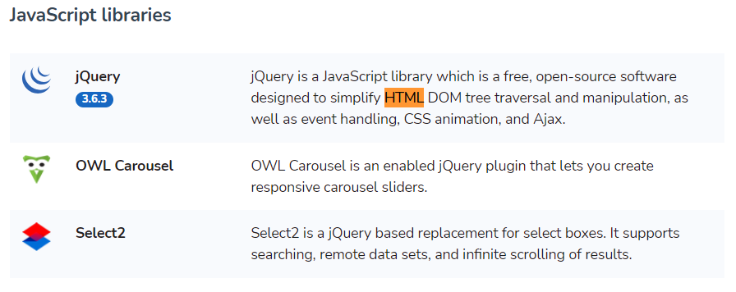
Technology Stack Analysis
WEBSITE DESIGNED WITH HTML CODE

Slide 6
WEB PAGE OPTIMIZATION REPORT
BY GOOGLE INSPECT

Slide 7
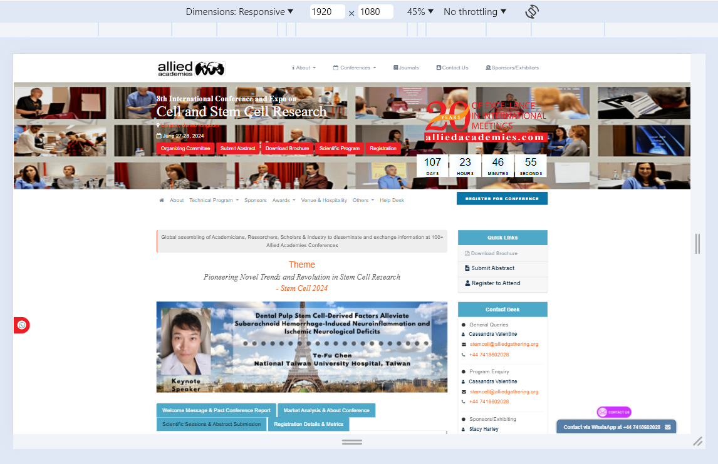
DESKTOP/LAPTOP | FULL SCREEN

Slide 8
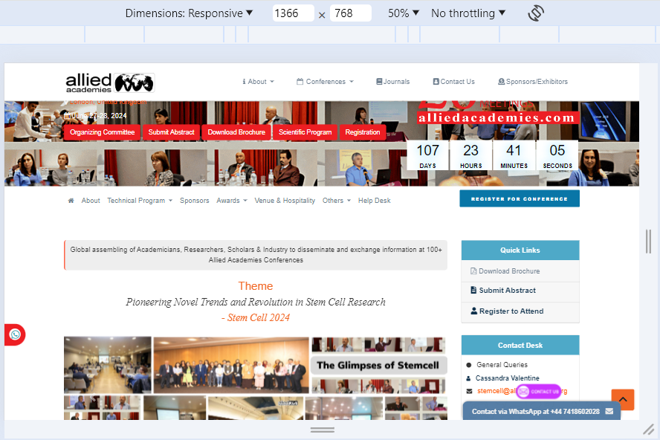
LAPTOP | MEDIUM SCREEN

Slide 9
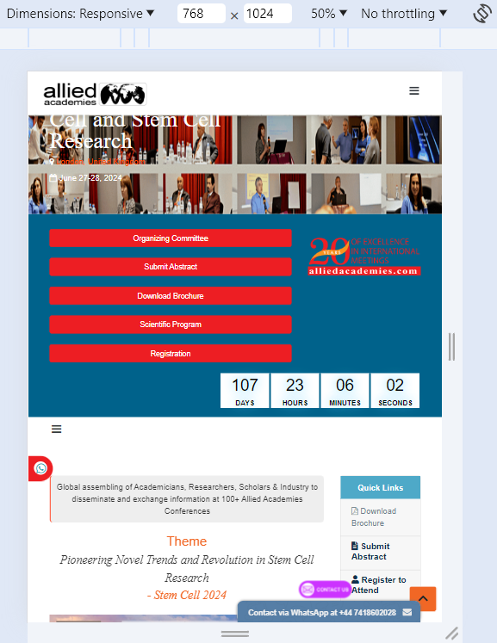
TABLET | PORTRAIT

Slide 10
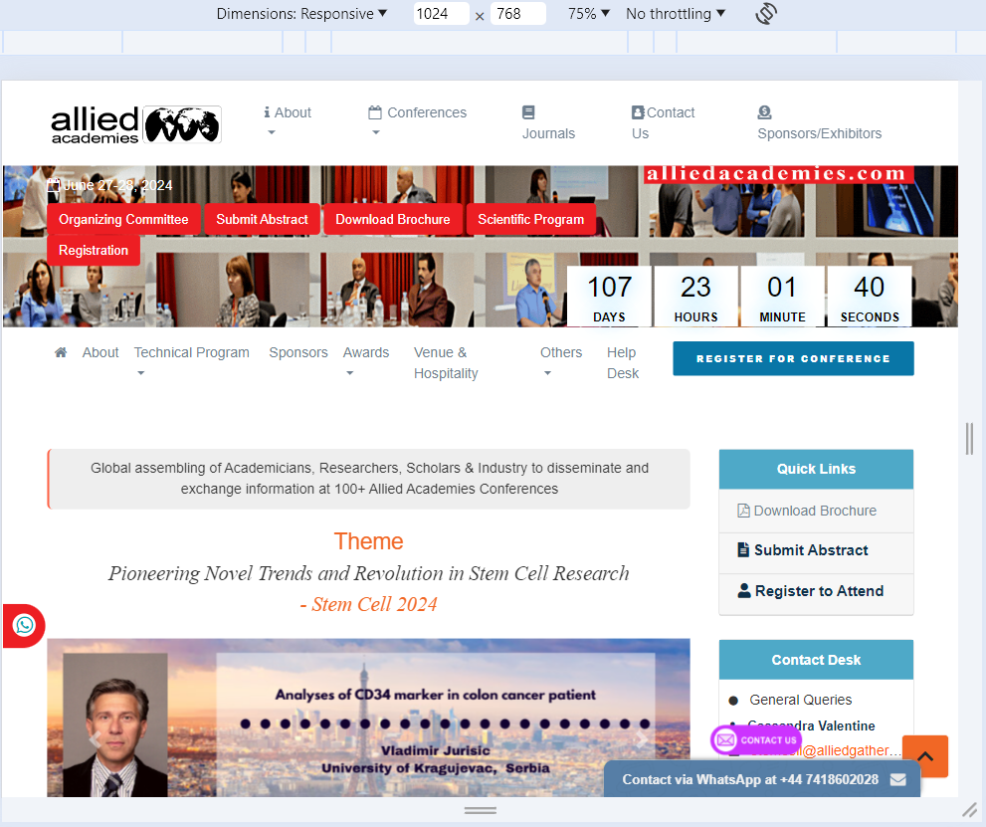
TABLET | LANDSCAPE

Slide 11
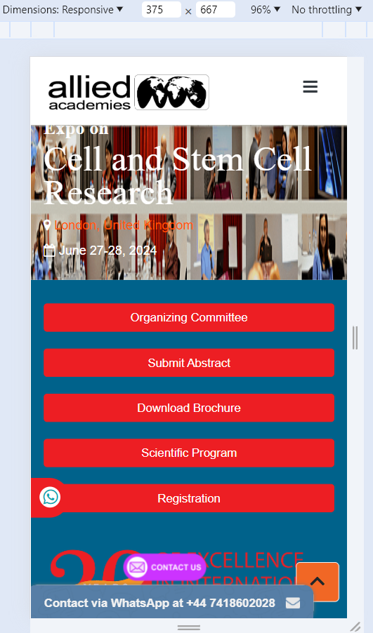
MOBILE | PORTRAIT

Slide 12
MEASURES of website handling IN REAL WORLD
CURRENT TRENDS CONTENT
MARKET ANALYSIS
TENTATIVE PROGRAM

Slide 13
BEST PRACTICES FOR CREATING WEBSITE DESIGNS
ACCESSIBLE DESIGN
TAILORING DESIGN RELATED TO PRODUCT OR SERVICE
RESPONSIVE DESIGN

